Slide 1

Study Report
Fu Kangwei
2019.10.10

Slide 2

About Bluetooth
Bluetooth is a wireless short-range communication technology.
Key features:
High robustness
Low power consumption
Low cost
Basic Rate (BR): 721.2 kb/s
Enhanced Data Rate (EDR): 2.1 Mb/s
Bluetooth Low Energy (BLE): Low complexity

Slide 3
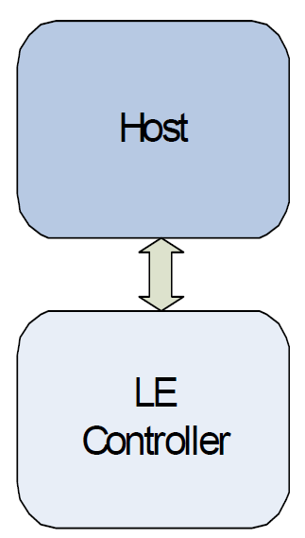
About Bluetooth
Host: All of the layers below the non-core profiles
and above the Host Controller Interface (HCI)
Core System Architecture
Controller: All of the layers below HCI

Slide 4
About BLE
Bluetooth Low Energy (BLE):
Lower cost
Lower complexity
Lower current consumption
Lower data rates
Lower duty cycles
Note: In poor RF environments, the LE system should be considered inherently unreliable!

Slide 5
Host
Channel Manager
L2CAP Resource Manager
Security Manager Protocol
Attribute Protocol
AMP Manager Protocol
Generic Attribute Profile
Generic Access Profile
Host

Slide 6
Host
Channel Manager: Create, manage and close L2CAP channels for the transport of service protocols and application data streams.
L2CAP Resource Manager: Manage the ordering of submission of PDU fragments to the baseband.
Security Manager Protocol: The peer-to-peer protocol used to generate encryption keys and identity keys.
Attribute Protocol: Implement the peer-to-peer protocol between an attribute server and an attribute client.

Slide 7
Host
AMP Manager Protocol: The layer that uses L2CAP to communicate with a peer AMP Manager on a remote device.
Generic Attribute Profile: Represent the functionality of the attribute server and, optionally, the attribute client.
Generic Access Profile: Represent the base functionality common to all Bluetooth devices.

Slide 8
LE Controller
Device Manager
Link Manager
Baseband Resource Manager
Link Controller
PHY
LE Controller

Slide 9
LE Controller
Device Manager: Functional block in the baseband that controls the general behavior of the Bluetooth device.
Link Manager: Create, modify and release of logical links, as well as update parameters related to physical links.
Baseband Resource Manager: All access to the radio medium.
Link Controller: Encode and decode of Bluetooth packets from the data payload and parameters.
PHY: Transmit and receive packets of information on the physical channel.

Slide 10
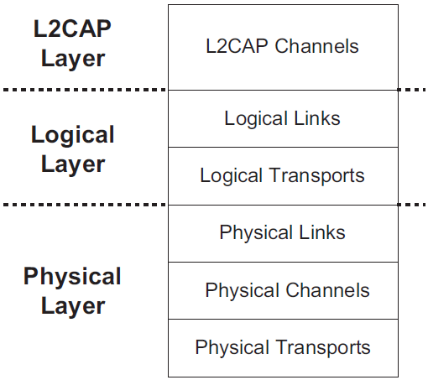
DATA TRANSPORT ARCHITECTURE
L2CAP Channels: Multiplex on one or more logical links.(在一个或多个逻辑链路上进行多路复用)
Logical Links: Provide an independent transport between two or more devices.
Logical Transports: Describe the inter-dependence between some of the logical link types.
Data Transport Architecture

Slide 11
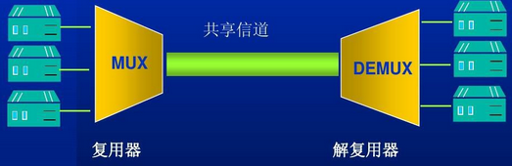
Knowledge: Multiplex
Combine multiple low-speed channels into one high-speed channel.
Establish multiple communication channels on one physical line.
Improve the utilization of data links effectively.
FDM (Frequency Division Multiplexing)
TDM (Time Division Multiplexing)
Multiplex
Multiplex Technology

Slide 12
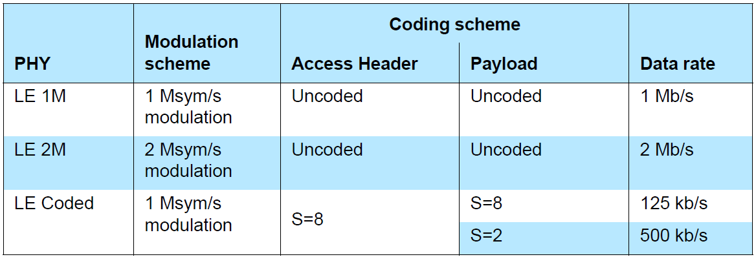
LE Generic Packet Structure
Based on three PHYs.
Make use of two modulation schemes.
Two coding schemes: S = 8 and S = 2 (S: The number of symbols per bit.
Uncoded PHYs: Each bit maps directly to a single radio symbol in the packet.
Coded PHYs: Error correction coded (使接收端收到的报文具有前向纠正的能力)

Slide 13
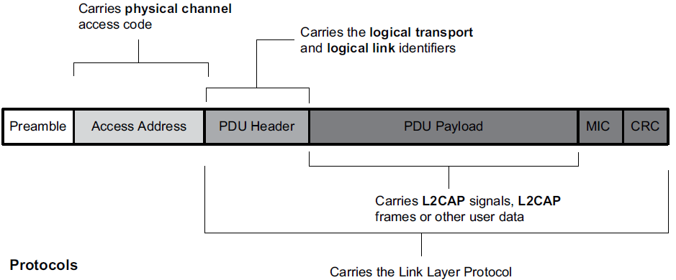
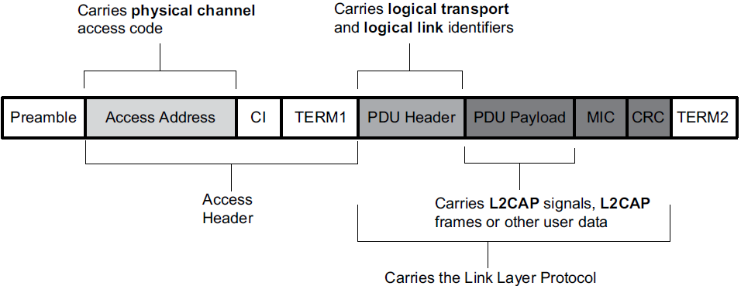
LE Generic Packet Structure
LE Uncoded PHYs
LE Coded PHY

Slide 14
LE Generic Packet Structure
Access Address: Identify communications on a physical channel.
PDU header: Determines the type of advertisement broadcast or logical link carried over the physical channel.
Message Integrity Check (MIC): Optional, used to authenticate the data PDU.
Cyclic Redundancy Check (CRC): Provides some integrity protection.

Slide 15
LE Physical Channels
Active Physical Link: Point-to-point link between the master and a slave.
Advertising Physical Link: Broadcast between the advertiser device and one or more scanner or initiator devices.
Periodic Physical Link: Broadcast between the advertiser device and one or more scanner devices.
Comment:
Advertiser: Broadcast advertising packets during advertising events on advertising channels.
Scanner: Listen for advertising events on the advertising channels.
Initiator: Listen on advertising channels for connectable advertising events to form connections.

Slide 16
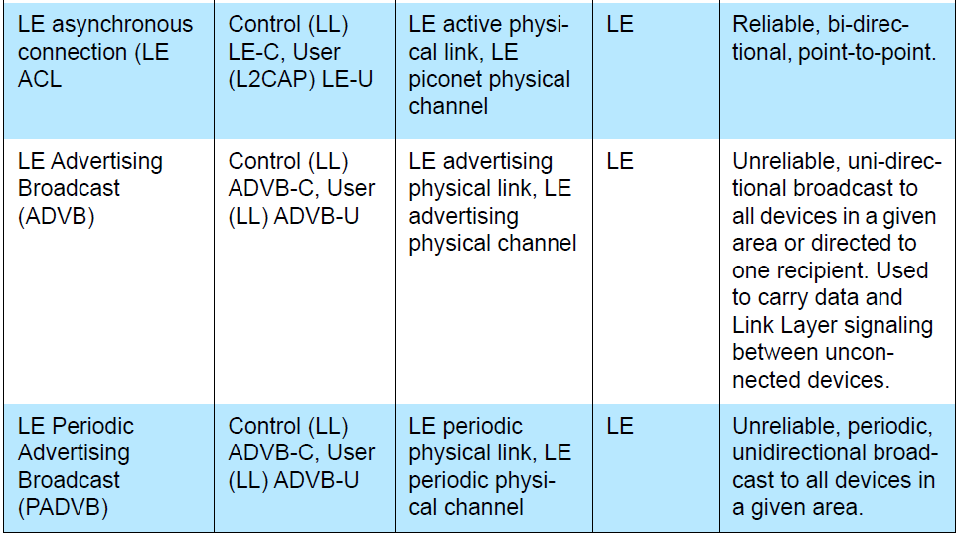
Logical Links & Logical Transports
A variety of logical links are available to support different application data transport requirements.
Each logical link is associated with a logical transport.
Logical transports are able to carry different types of logical links.

Slide 17
Link Type
Casting: Unicast or Broadcast.
Unicast links: Between two endpoints; Either direction on unicast links.
Broadcast links: Between one source device and zero or more receiver devices; Unidirectional, connectionless.
2) Scheduling and Acknowledgment Scheme: Type of traffic.
Synchronous links: Suitable for constant rate isochronous data.
Asynchronous links: No time-based characteristics.
Isochronous links: Have time-based characteristics.
3) Class of Data:
Control links: Transport LMP messages between two link managers.
L2CAP links: Transport L2CAP PDU.
Stream links: Transport user data.

Slide 18
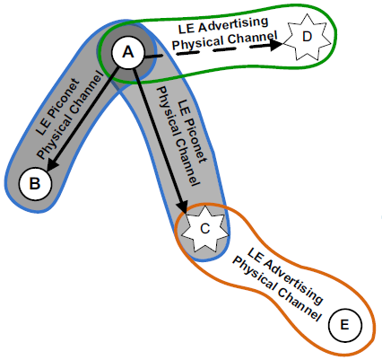
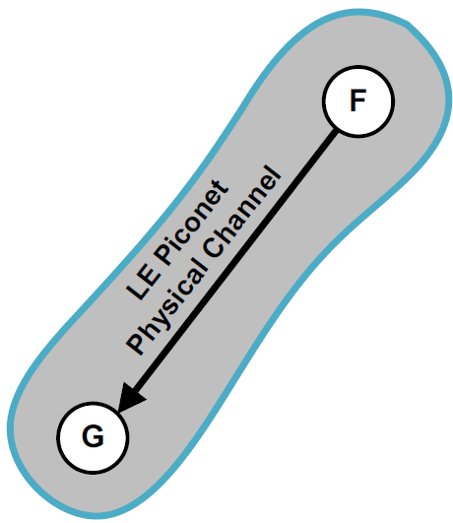
LE Topology
F : Master
G: Slave
A : Master
B & C : Slave
D is advertiser and A is initiator (group D).
E is scanner and C is advertiser (group C).
A & B use one LE piconet physical channel.
A & C use another LE piconet physical channel.

Slide 19
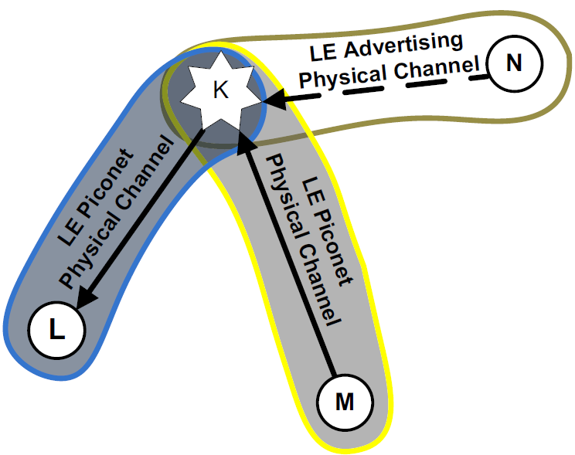
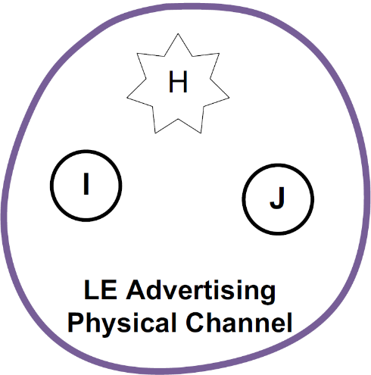
LE Topology
K: master of L
K: slave of M
H is advertiser, I & J are scanners (group H).
K is advertiser, N is initiator (group K).
K and L use one LE piconet physical channel.
K and M use another LE piconet physical channel.

Slide 20
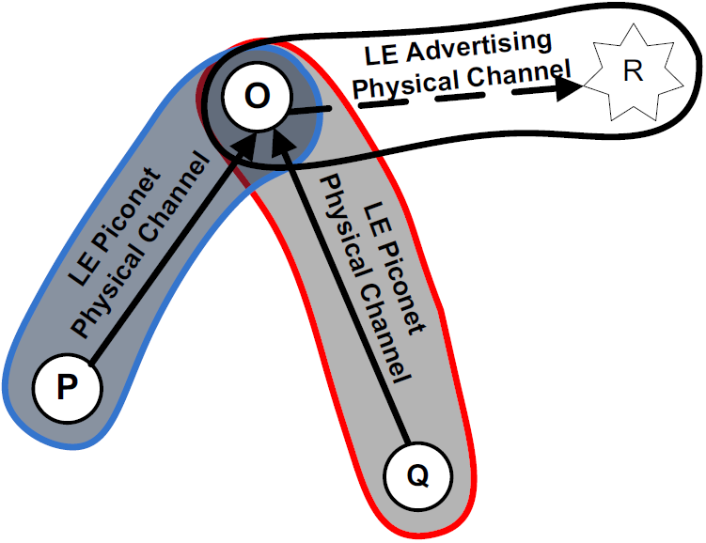
LE Topology
O: Slave of P and Q
R is advertiser, O is initiator (group R).
O & P use one LE piconet physical channel.
O & Q use another LE piconet physical channel.

Slide 21
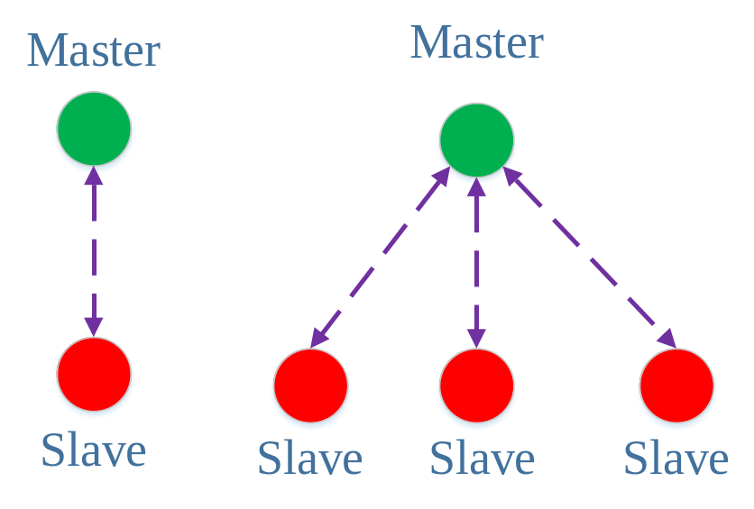
Piconet
Piconet: Device network that shares one physical channel.
Master: Only 1 device.
Slave: other devices, most 7 active slaves.

Slide 22
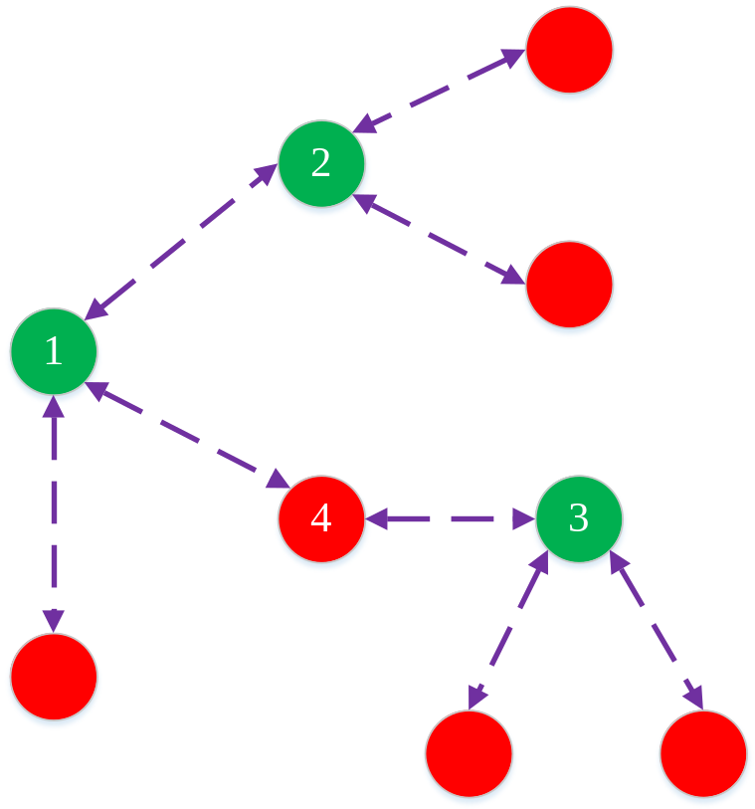
Scatternet
Scatternet: Set of Piconets.
Devices have two rules: Master or Slave.
Note: Device should be master in its own piconet!

Slide 23
LE Procedures
Device filtering
Advertising
Scanning
Discovering
Connecting
Connected Mode
Periodic Advertising
Periodic Advertising Synchronization Periodic
Advertising Synchronized Mode
LE Procedures

Slide 24
LE Procedures
Device filtering: a method for Controllers to reduce the number of devices requiring communication responses.
Advertising: Advertisers use advertising to perform unidirectional broadcasts to devices in the area without a connection.
Scanning: Scanning devices use scanning to listen for unidirectional broadcasts of user data from advertising devices using the advertising channel.
Discovering: A device that tries to find other nearby devices.
Connecting: one device carries out the advertising while the other one carries out the scanning.

Slide 25
LE Procedures
Connected Mode: the devices are physically connected to each other within a piconet.
Periodic Advertising: An advertiser uses periodic advertising to perform unidirectional periodic broadcasts to devices in the area.
Periodic Advertising Synchronization Periodic: one device carries out advertising while the other device carries out scanning.
Advertising Synchronized Mode: There is a periodic physical channel to which they are both synchronized.

Slide 26
Security Architecture
Pairing
Bonding
Device authentication
Encryption
Message integrity
Distinct security features

Slide 27
Security Architecture
Pairing: Create one or more shared secret keys.
Bonding: Store the keys created during pairing.
Device authentication: Verification that the two devices have the same keys.
Encryption: Message confidentiality.
Message integrity: Protects against message forgeries.

Slide 28
Le Security
Bluetooth LE uses multiple keys, each for a specific purpose:
Confidentiality of data and device authentication
Authentication of unencrypted data
Device Identity
Key generation:
Performed by Host on each LE device.
Independent of any other LE device.
LE uses AES-CCM cryptography which is performed in Controller.

Slide 29
Le Security
Signed Data & Signature
Sending device: Place a signature after Data PDU.
Receiving device: Verify the signature.
If the signature is verified, Data PDU is assumed to come from the trusted source.

Slide 30
BLUETOOTH APPLICATION ARCHITECTURE
Bluetooth profile defines:
The required functions of each layer from PHY to L2CAP.
The required features of each layer from PHY to L2CAP.
Any other protocols outside of the Core specification.
Vertical interactions between the layers
Peer-to-peer interactions of specific layers between devices.

Slide 31
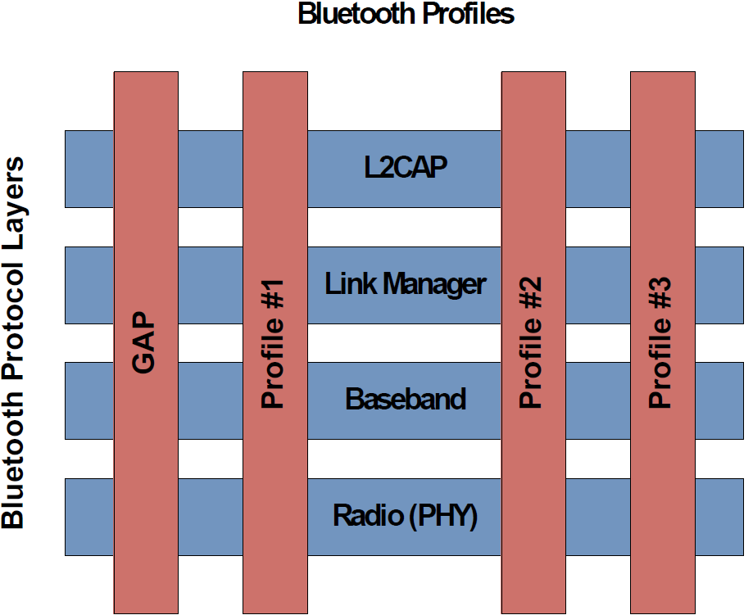
BLUETOOTH APPLICATION ARCHITECTURE

Slide 32
Generic Access Profile (GAP)
GAP defines the basic requirements of a Bluetooth device.
Broadcaster: Use advertising to broadcast data.
Observer: Receive broadcast data contained in advertisements.
Peripheral: Support a single connection.
Central: Support multiple connections.
GAP in LE

Slide 33
ATT & GATT
Attribute Protocol (ATT): Implement the peer-to-peer protocol between an attribute server and an attribute client.
ATT client: Send commands, requests, and confirmations to ATT server.
ATT server: Send responses, notifications and indications to ATT client.

Slide 34
ATT & GATT
Generic Attribute (GATT):
Represent the functionality of ATT server, optionally, ATT client.
Describe the hierarchy of services, characteristics and attributes used in ATT server.
Provide interfaces for discovering, reading, writing and indicating of service characteristics and attributes.
Used on LE devices for LE profile service discovery.

Slide 35
ATT & GATT
GATT server:
Store the data transported over ATT.
Accept ATT requests, commands and confirmations from GATT client.
Send indication and notifications asynchronously to GATT client when specified events occur on GATT server.

Slide 36
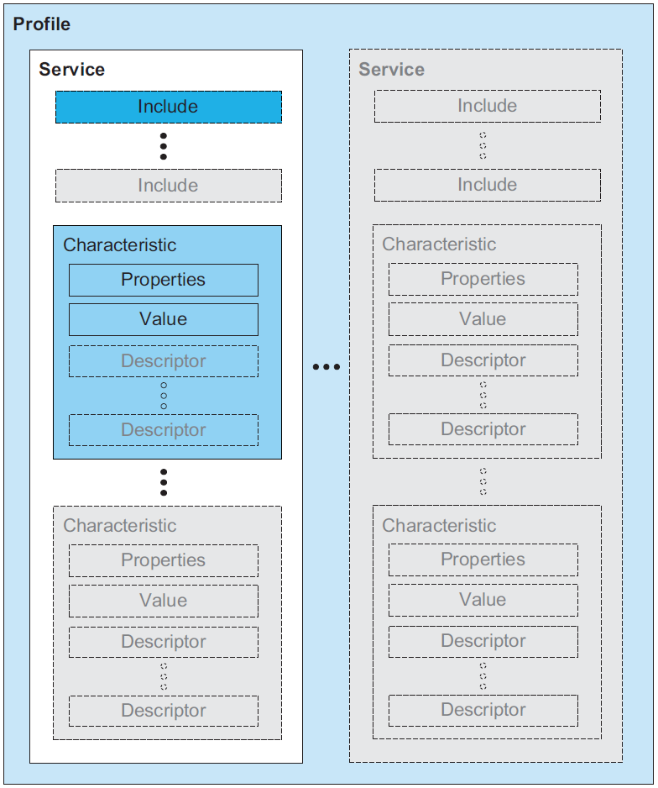
GATT-BASED PROFILE HIERARCHY
GATT Profile:
Specify the structure in which profile data is exchanged.
This structure defines basic elements such as services and characteristics.

Slide 37
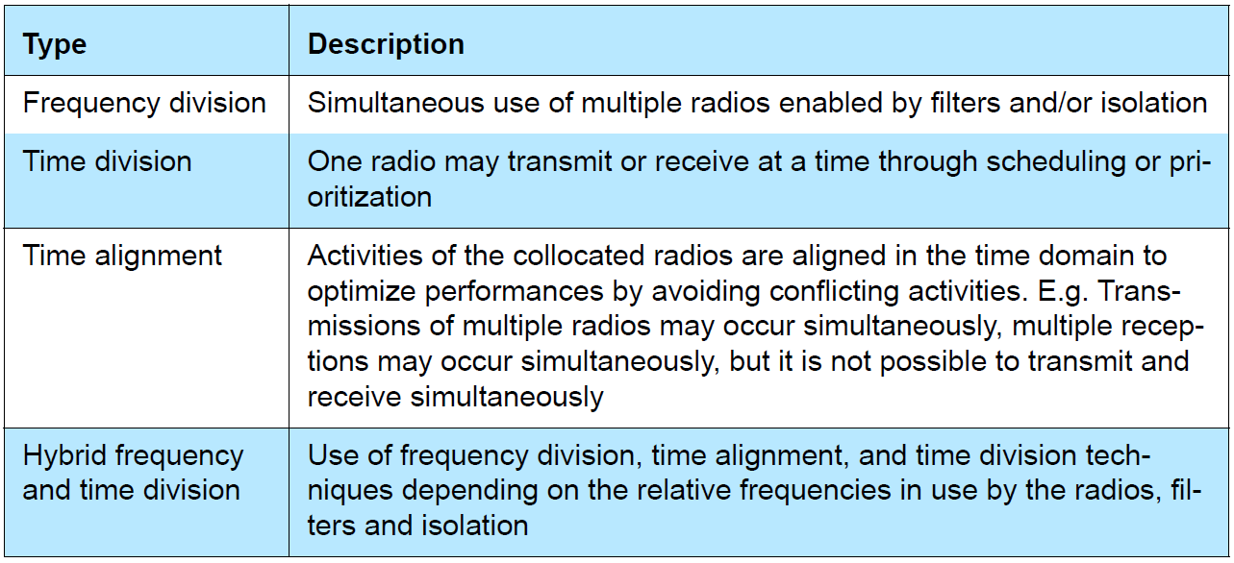
COEXISTENCE AND COLLOCATION
Reason: Many devices operate in the unlicensed 2.4 GHz ISM band.
Solutions: The following categories:

